Slide 1
Ensemble Methods
10/28/2019
Track II: 158273
http://bit.ly/2JqDQo6

Slide 2
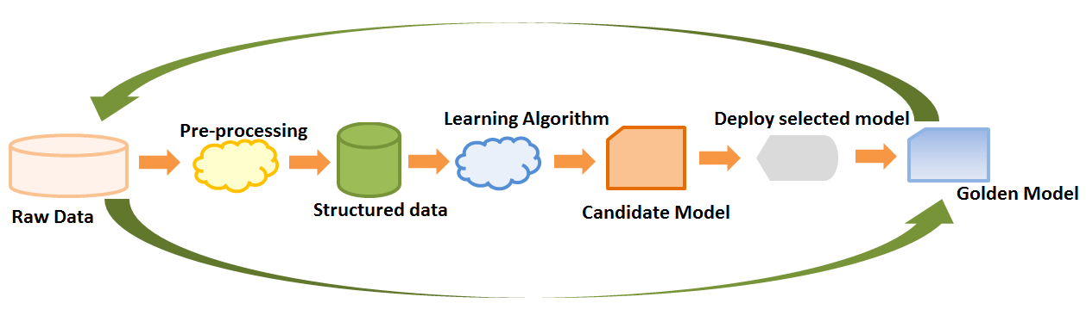

Slide 3
How do we pick our model?

Slide 4
We might consider…
Our goal
Quantity of data
Dimensionality of the feature space
Data Distribution

Slide 5
We might consider…
Our goal
Quantity of data
Dimensionality of the feature space
Data Distribution
Is a single model good enough for our problem?

Slide 6
Model 1
Model 2
Prediction
Data
Model 3

Slide 7
Before diving into ensemble methods
Bias Difference between the average prediction of our model and the correct value which we are trying to predict
Variance Variability (spreadness) of model prediction for a given data point or a value

Slide 8
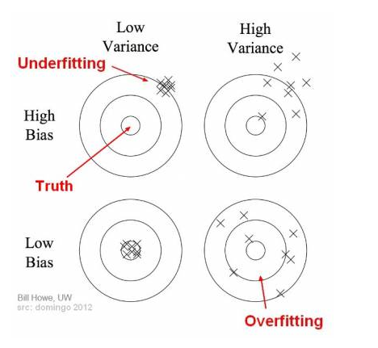
Before diving into ensemble methods

Slide 9
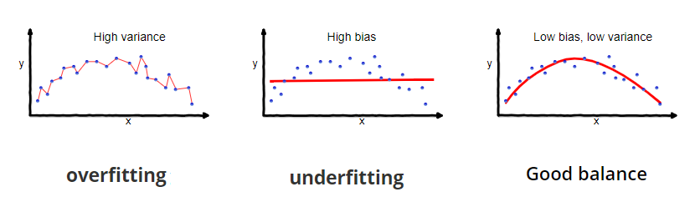
In terms of data and performance:

Slide 10
In terms of data and performance:
Many have either too high variance or too high bias

Slide 11
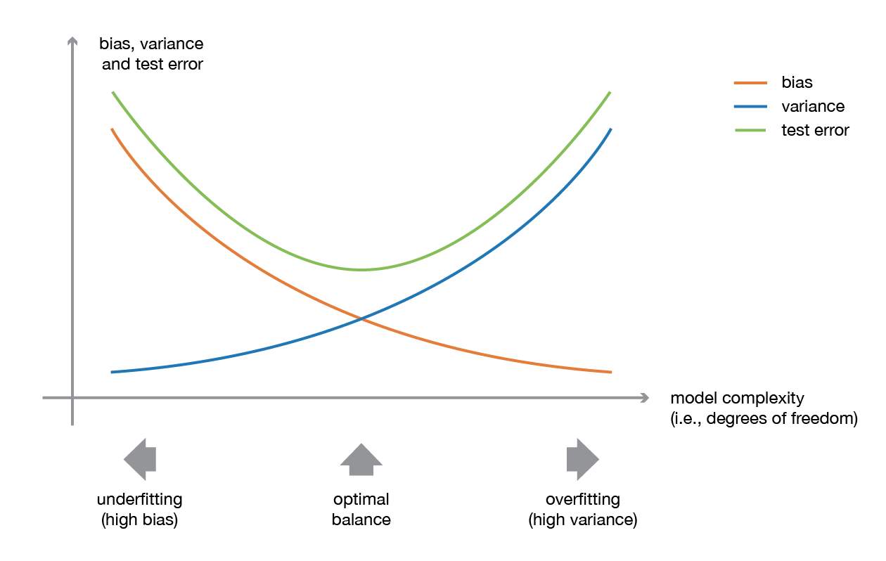
Ideally we want:

Slide 12
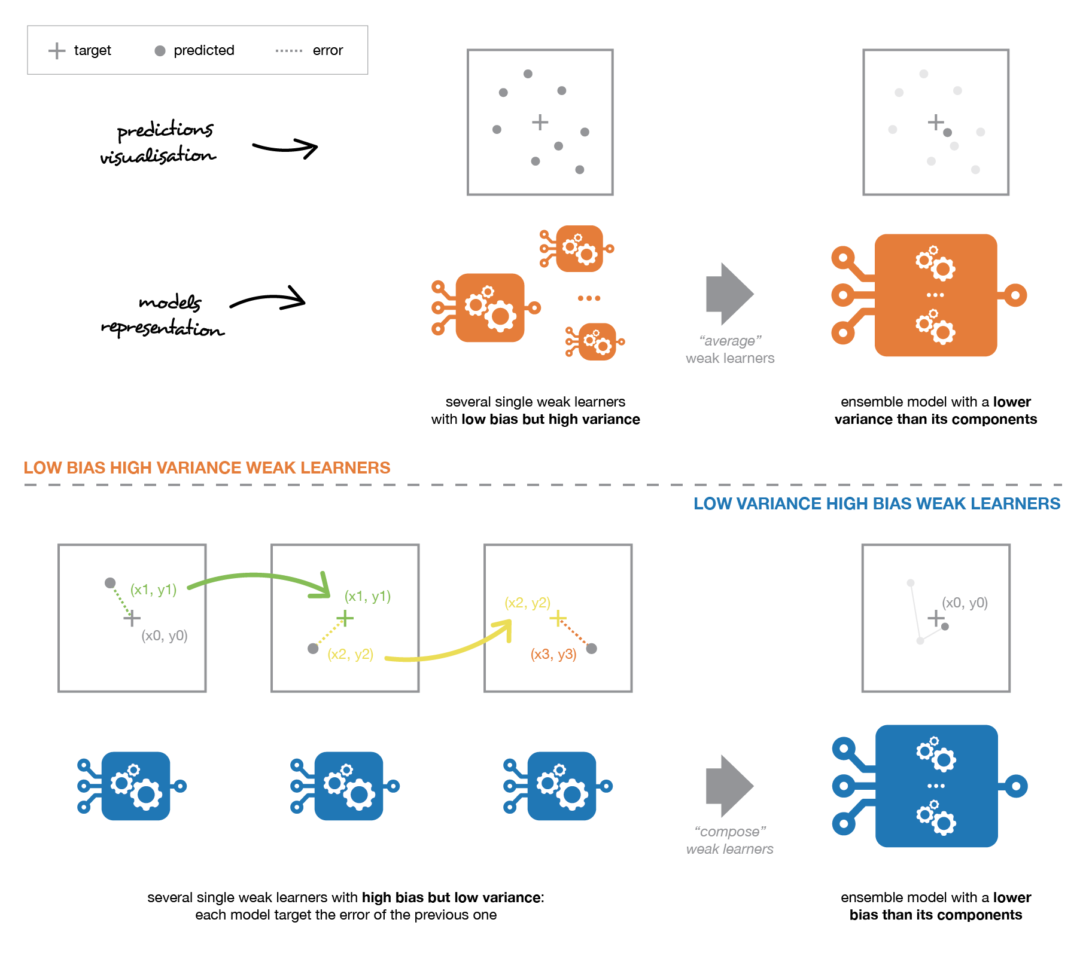
To improve high variance learners

Slide 13
Similarly, for high bias:

Slide 14
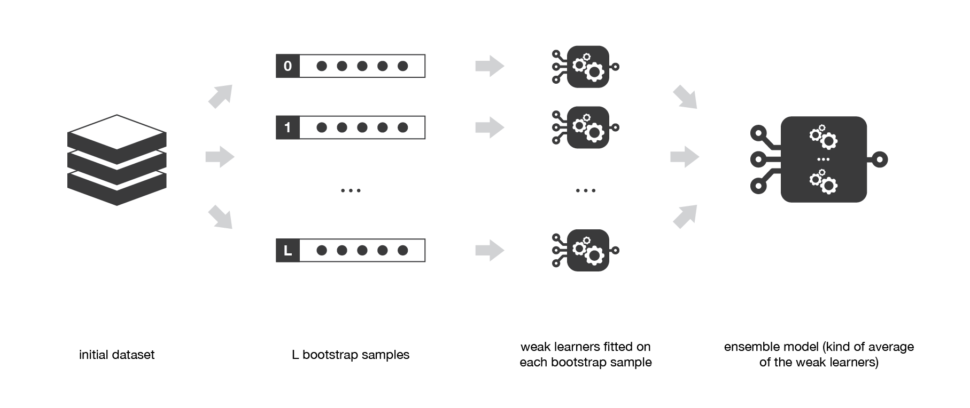
Bagging = Bootstrap Aggregating

Slide 15
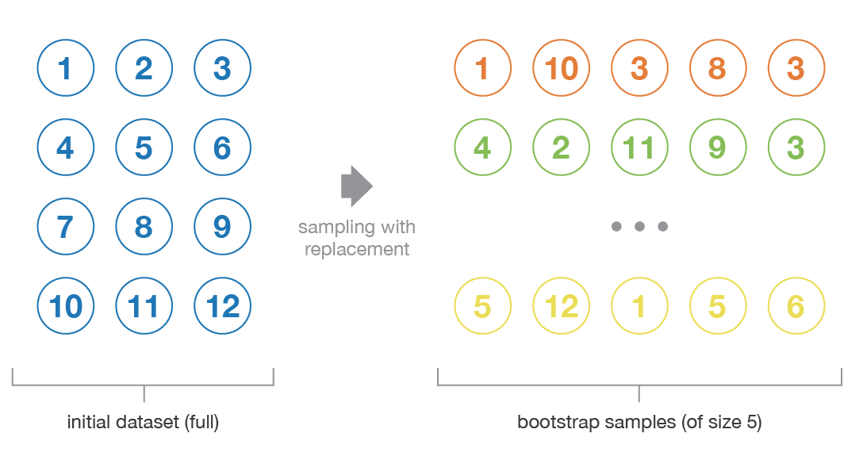
Bootstrap
Sampling multiple times with replacement
Independent samples
Representative of true data distribution

Slide 16
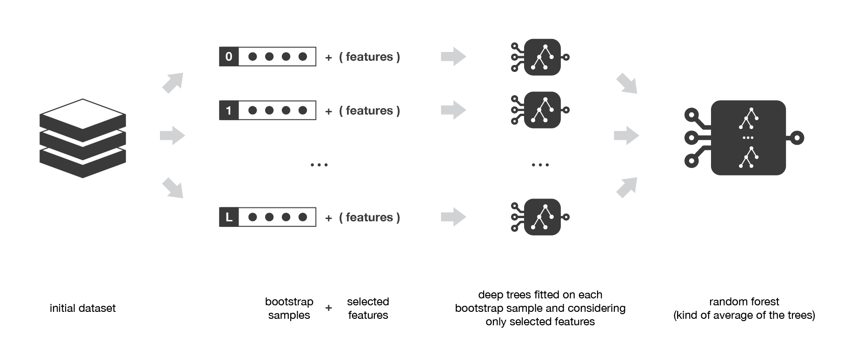
Random Forest:
Bagging + Feature Sampling

Slide 17
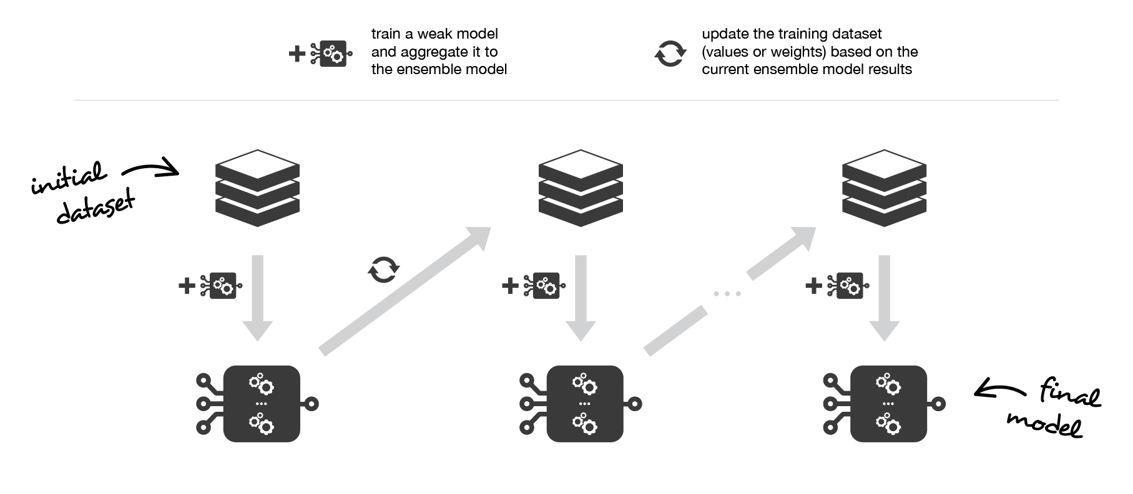
Boosting
Sequential models trained upon results of the previous classifiers
Tells the next model which data points are difficult to classify (mis-classified ones)

Slide 18
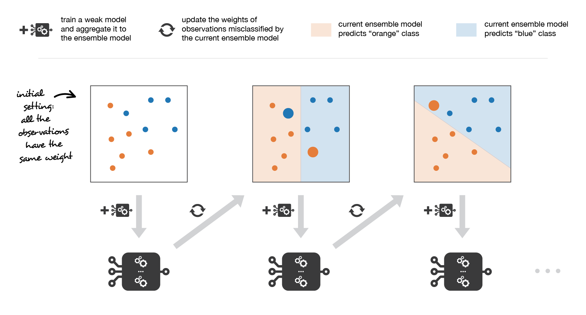
Adaboosting: Adaptive Boosting

Slide 19
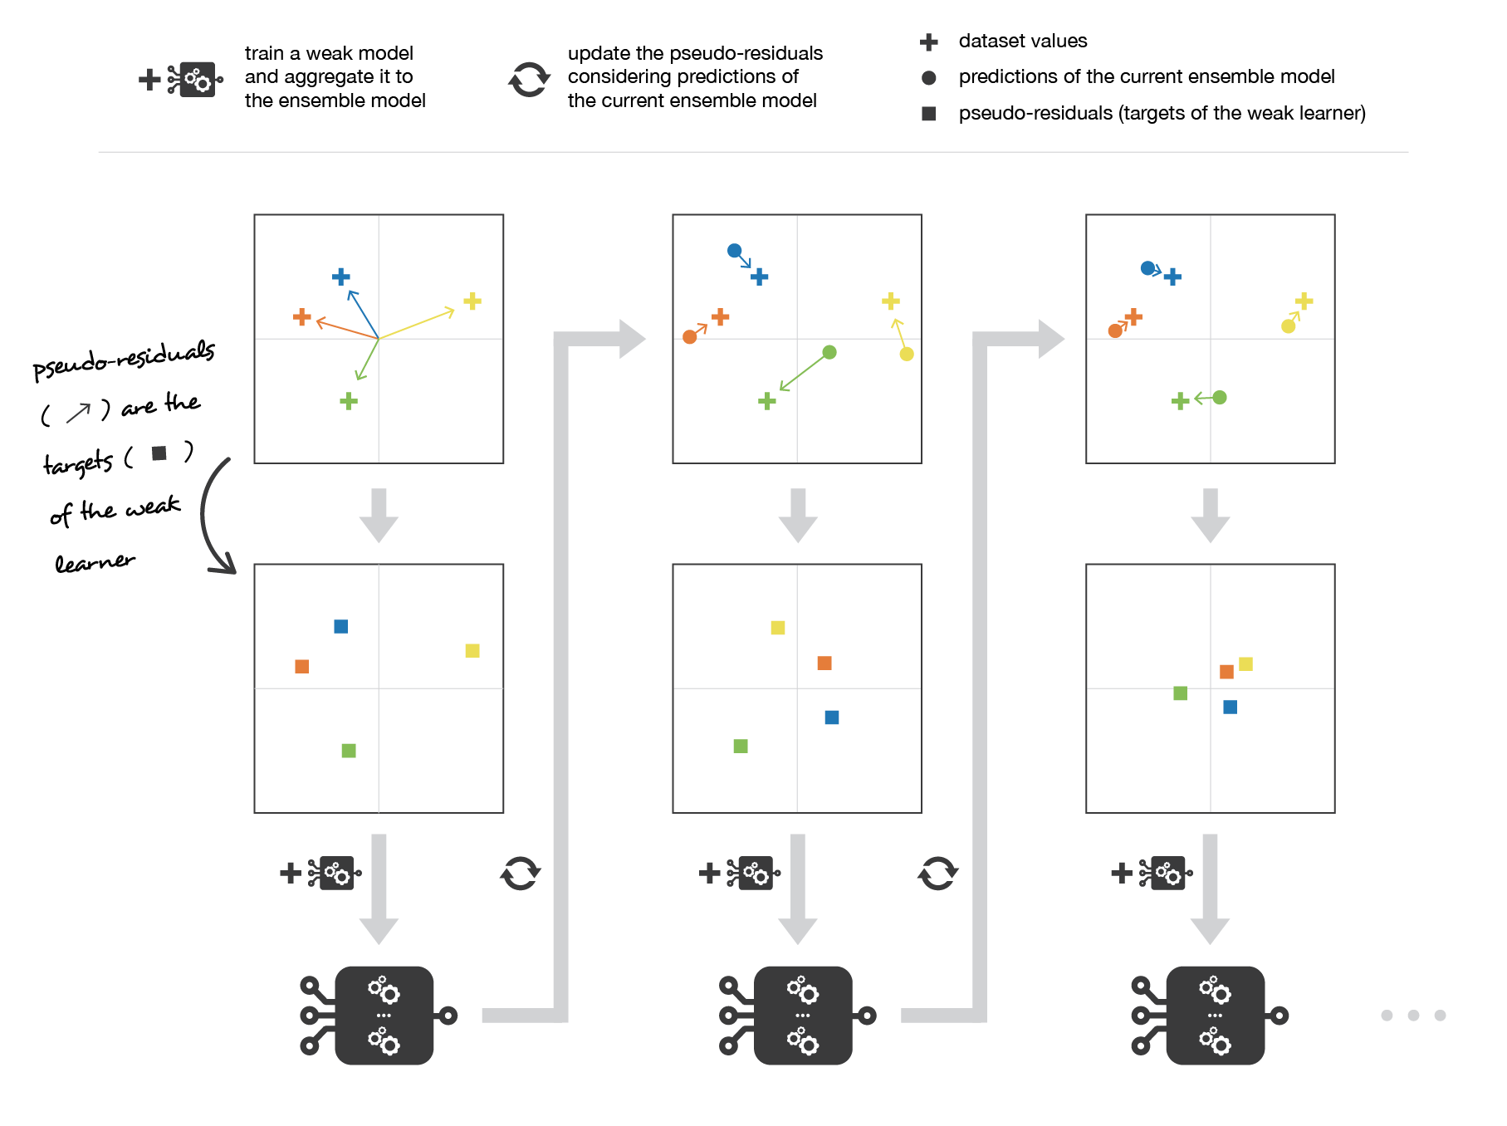
Gradient Boosting

Slide 20
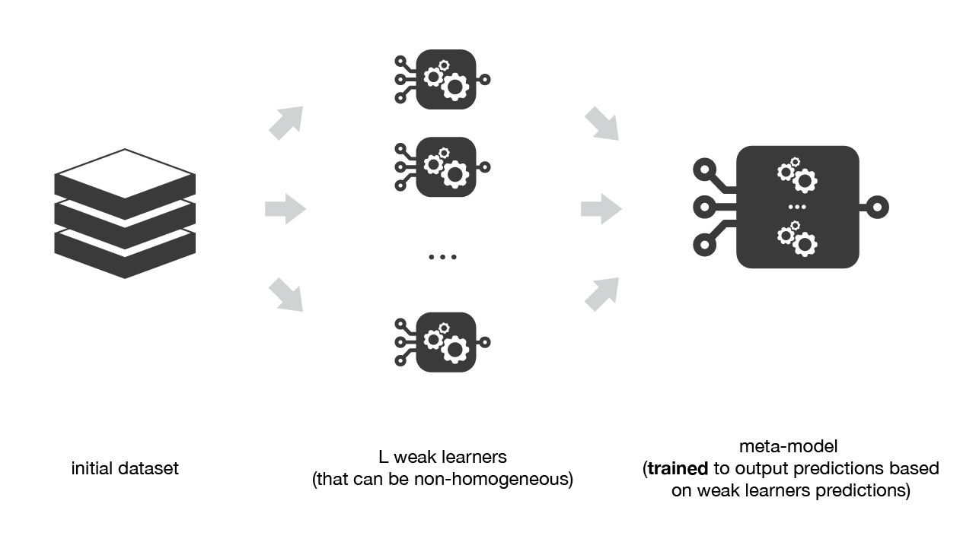
Stacking

Slide 21
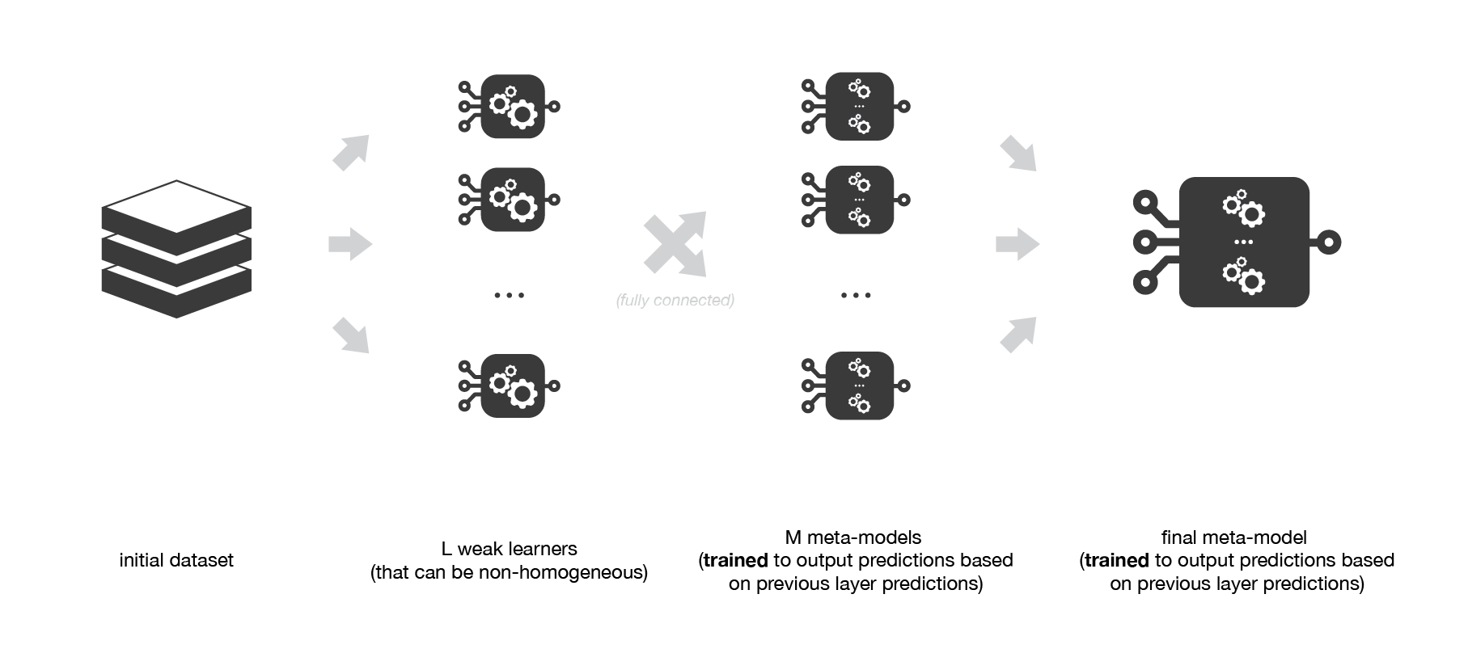
You can also add layers

Slide 22
Coding Time!

